Slide 2

Young Professionals Program 4
Intern Huy Phan | 2025

Slide 3

Visit to Ho Chi Minh City History Museum
Intern Huy Phan | 2025

Slide 4
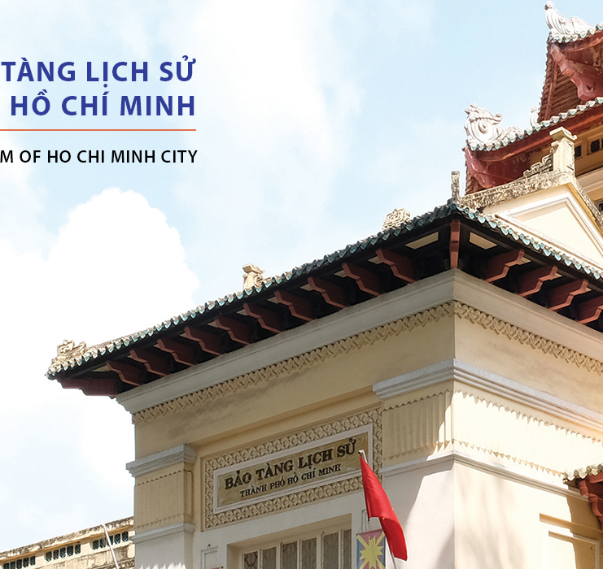
Agenda
Introduction & Purpose of the Visit
Museum Overview
Vietnamese History – Key Highlights
Ethnic & Asian Cultures – Overview
Tây Sơn Era – Historical Context
Tây Sơn Military Achievements
Tây Sơn Dynasty & Reforms
Legacy of the Tây Sơn Era
Conclusion – Reflections from the Visit
Q&A and Discussion

Slide 5

Museum Visit: Exploring the Tây Sơn Era
Intern Huy Phan | 2025

Slide 6
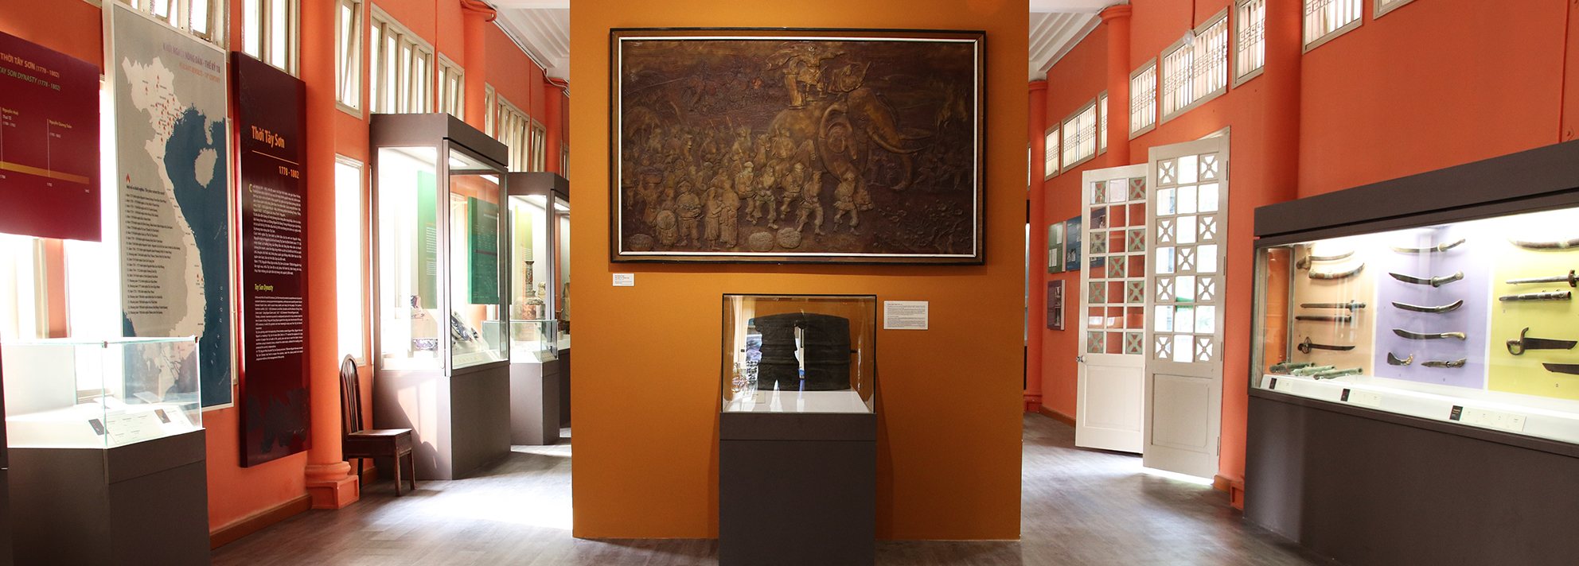
Museum Visit: Exploring the Tây Sơn Era
Main content:
A journey through Vietnamese history from prehistoric times to the Nguyễn dynasty
Focus on the Tây Sơn period (Room 10) – a heroic era of national unification
Brief introduction to other historical periods and cultures

Slide 7
Museum Overview Ho Chi Minh City History Museum
Intern Huy Phan | 2025

Slide 8
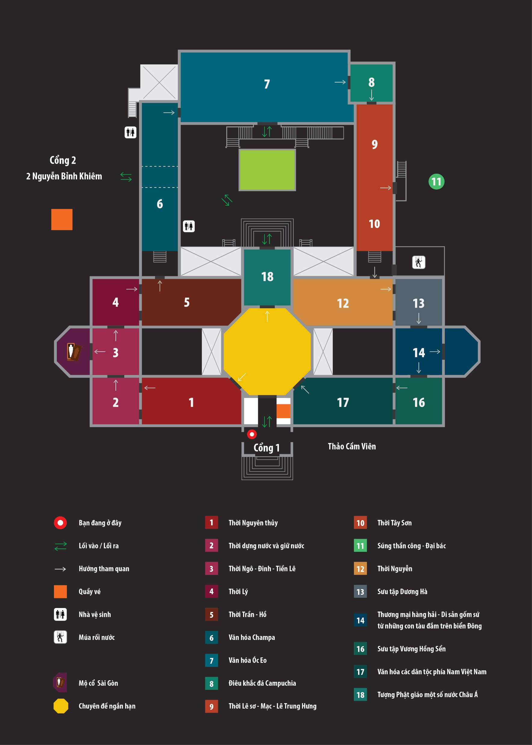
Museum Overview
Part 1: Vietnamese History(Rooms 1–12)
From prehistoric times (500,000 years ago) to the August Revolution (1945)
Part 2: Southern & Asian Cultures (Rooms 6–8, 13–18)
Champa, Óc Eo, Cambodian sculpture, ceramics, mummies, antique collections

Slide 9
Vietnamese History – Overview
Intern Huy Phan | 2025

Slide 10
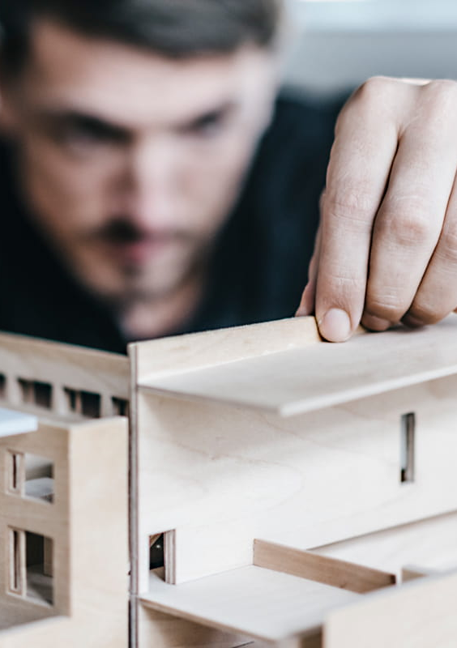
Vietnamese History
Room 1: Prehistoric era – stone tools, Hòa Bình & Bắc Sơn cultures
Room 2: Nation-building – Văn Lang, Phù Nam, Lâm Ấp; 1,000 years of Chinese rule
Room 3: Ngô - Đinh - Early Lê – Ngô Quyền’s victory at Bạch Đằng (938)
Room 4: Lý dynasty – Capital at Thăng Long, Temple of Literature, defeat of Song dynasty
Room 5: Trần - Hồ – Three victories over Mongol invasions, Đại Việt civilization
Room 9: Lê sơ - Mạc - Lê Trung Hưng – Lam Sơn uprising, internal divisions
Room 12: Nguyễn dynasty – Unification, French colonial period, August Revolution

Slide 11
Ethnic & Asian Cultures – Overview
Intern Huy Phan | 2025

Slide 12
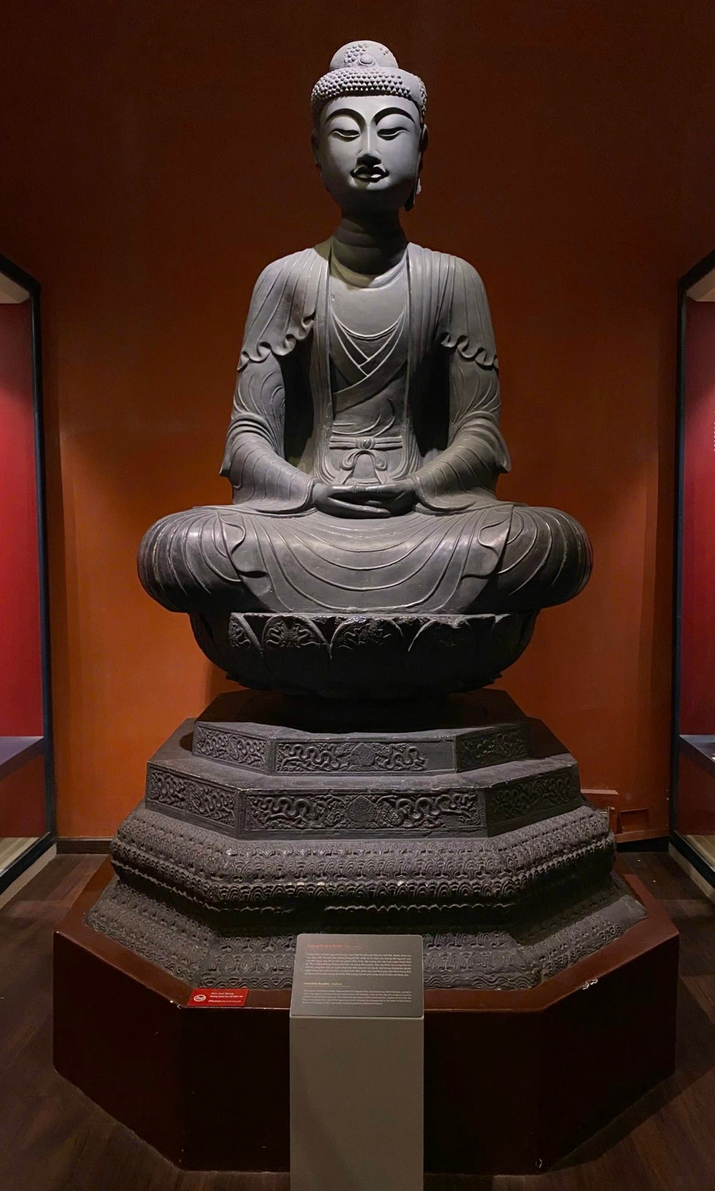
Ethnic & Asian Cultures – Overview
Room 6: Champa – Brick temples, Buddhist statues, Indian influence
Room 7: Óc Eo – Gold jewelry, international trade connections
Room 8: Cambodian sculpture – Angkor Wat, intricate bas-reliefs
Rooms 13–16: Dương Hà and Vương Hồng Sển collections, Asian ceramics, Xóm Cải mummy
Rooms 17–18: Cultures of Vietnam’s 54 ethnic groups, Asian Buddhist statues

Slide 13
Tây Sơn Era
Intern Huy Phan | 2025

Slide 14
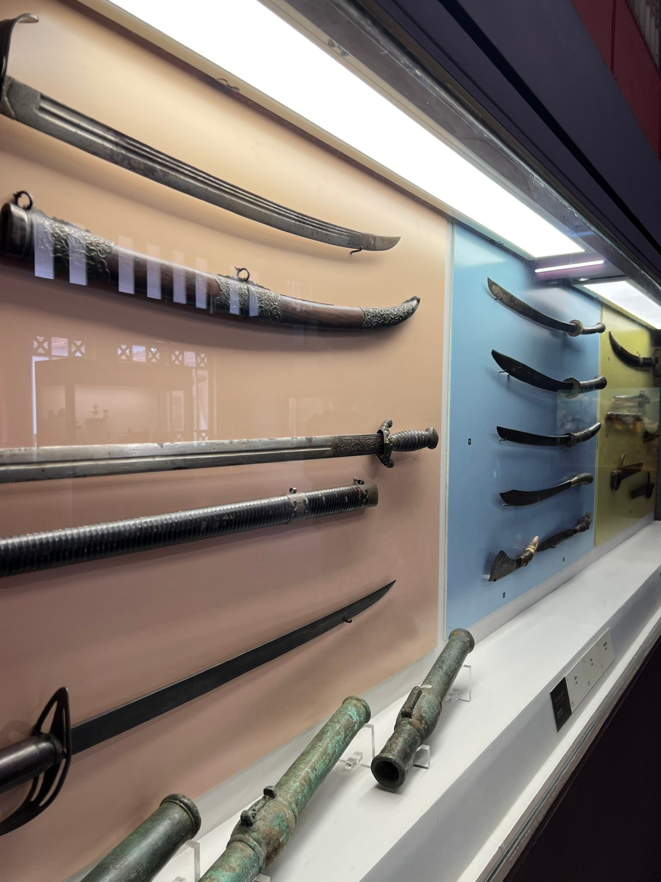
Historical Context Tây Sơn Uprising (1771)
Background:
Divided country: Lê - Trịnh (North), Nguyễn (South)
Peasants oppressed, widespread uprisings
The uprising:
Broke out in Quy Nhơn (1771), led by Nguyễn Nhạc, Nguyễn Huệ, Nguyễn Lữ
Supported by peasants & ethnic minorities, grew into a mass movement
Meaning:
Represented the aspiration for unity & social justice

Slide 15
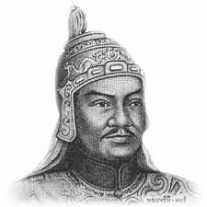
Military Achievements Defending Independence & National Unification
Major victories:
Overthrew Nguyễn lords (South), defeated Siamese army (1785, Rạch Gầm - Xoài Mút)
Crushed Trịnh lords & Lê dynasty (North)
Defeated Qing army (1789, Ngọc Hồi - Đống Đa) – legendary rapid victory
Meaning:
Unified the country after 150 years of division
Affirmed the principle “People as the foundation,” showcased Nguyễn Huệ’s brilliant strategies

Slide 16
Building the Dynasty & Reforms
Formation:
Nguyễn Nhạc founded the dynasty (1778, Quy Nhơn)
Nguyễn Huệ crowned Emperor Quang Trung (1788, Phú Xuân)
Progressive reforms:
Economy: Land redistribution, frontier development, reduced taxes
Culture: Promoted Chữ Nôm, built schools, preserved heritage
Military & diplomacy: Built regular army, secured borders
Meaning:
Economic recovery, cultural revival, modernization of the nation

Slide 17
Legacy of the Tây Sơn Era Indomitable National Spirit
Culture:
Works like Chiếu cầu hiền (Edict Seeking the Talented) called for national talents
Victory festivals preserved heroic spirit
Influence:
Aroused national unity awareness
Inspired later struggles for independence

Slide 18

Conclusion The Meaning of the Museum Visit
Intern Huy Phan | 2025

Slide 19
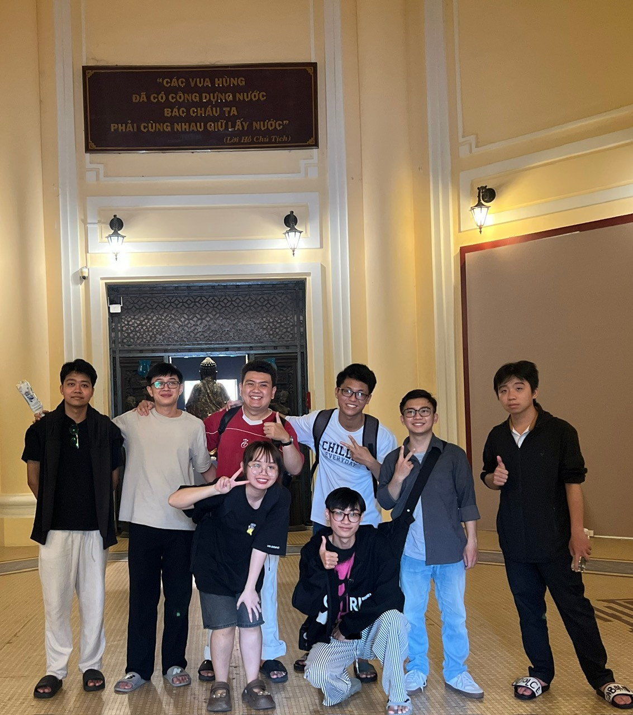
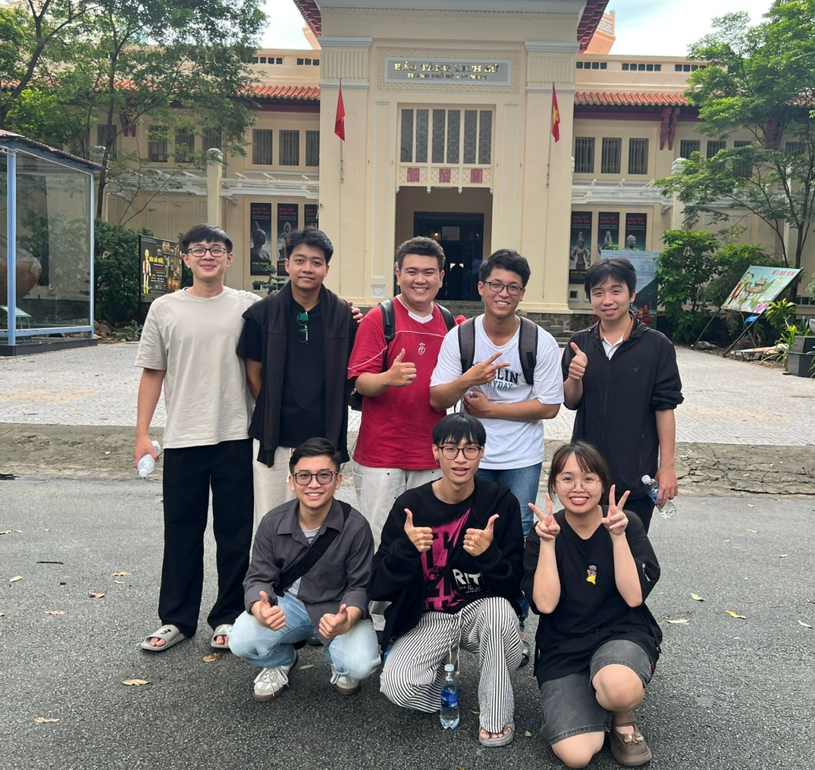
Conclusion The Meaning of the Museum Visit

Slide 20
Questions & Discussion
Intern Huy Phan | 2025

